Slide 1
Taskgalaxy - Task Manager With Progress Tracker
CAPSTONE PROJECT
Presented By:
1. Madhuri Gokul Patil – Usha Mittal Institute of Technology – Department of Computer Science and Technology (B.Tech)

Slide 2
OUTLINE
Problem Statement (Should not include solution)
System Development Approach (Technology Used)
Algorithm & Deployment (Step by Step Procedure)
Result
Conclusion
Future Scope(Optional)
References

Slide 3
Problem Statement
Users struggle with managing daily tasks and lack effective tracking mechanisms.
The absence of a visual tool leads to low personal productivity and poor time management.
Existing solutions are often too complex or costly for simple, personal use.
We need a lightweight application for adding, editing, and completing tasks seamlessly.
The solution must offer clear progress visualization (progress bar) to motivate completion.
The goal is a user-friendly, client-side manager with persistent data storage (Local Storage).

Slide 4
System Approach
Technologies Used
HTML5 (index.html): Provides the structure of the application, including the header, task list, search bar, filter/sort controls, and the task modal.
CSS3 (style.css): Handles styling and responsive layouts for a modern, dark-themed, and user-friendly interface. It also manages visual cues for task priority (e.g., high, medium, low).
JavaScript (script.js): Implements all dynamic interactivity, including CRUD (Create, Read, Update, Delete) operations, filtering, sorting, progress calculation, and using Local Storage for persistent data.
Design Approach
Clean and User-Friendly Interface
Mobile-Responsive Design
Modular Separation of HTML, CSS, and JS files

Slide 5
Algorithm & LOGIC
I. Data Management & Persistence
Task Structure: Tasks are defined with key fields: Title, Due Date, Priority (High/Medium/Low), Notes, and Tags.
Data Persistence: Implemented the Local Storage using dedicated functions (saveToStorage, loadFromStorage) to ensure tasks are saved across sessions.
CRUD Operations: Core JavaScript functions manage Adding, Editing, and Deleting tasks from the array.
II. Interactive Functionality
Completion Toggle: The toggleTaskStatus function flips the task's done property and visually updates the list (strikethrough).
Real-time Progress: The renderProgress function dynamically calculates (Completed​/Total) and updates the progress bar.
Filtering & Sorting: Implemented logic for filtering by status (Active/Completed) and sorting by Priority (using a map) or Due Date.
User Interface: A single Modal View is utilized for both creating and editing task details.

Slide 6
TESTING & DEPLOYMENT
I. Application Feedback & Testing
Visual Feedback: Triggers a Confetti Effect upon achieving 100% completion (All tasks done).
Styling Cues: Implemented Priority Color-Coding (Red/High, Green/Low) and visual cues for Overdue Tasks.
Cross-browser Compatibility: Ensured consistent functionality across major web browsers.
Responsiveness: Utilized CSS Media Queries to guarantee a fully functional and readable layout on all mobile devices.
II. Deployment Strategy
Model: The project is a pure Client-Side Application (HTML, CSS, JavaScript).
Hosting Platform: Hosted easily and for free using GitHub Pages.
Process: Deployment involves simply pushing the source code to GitHub and enabling the hosting service.

Slide 7
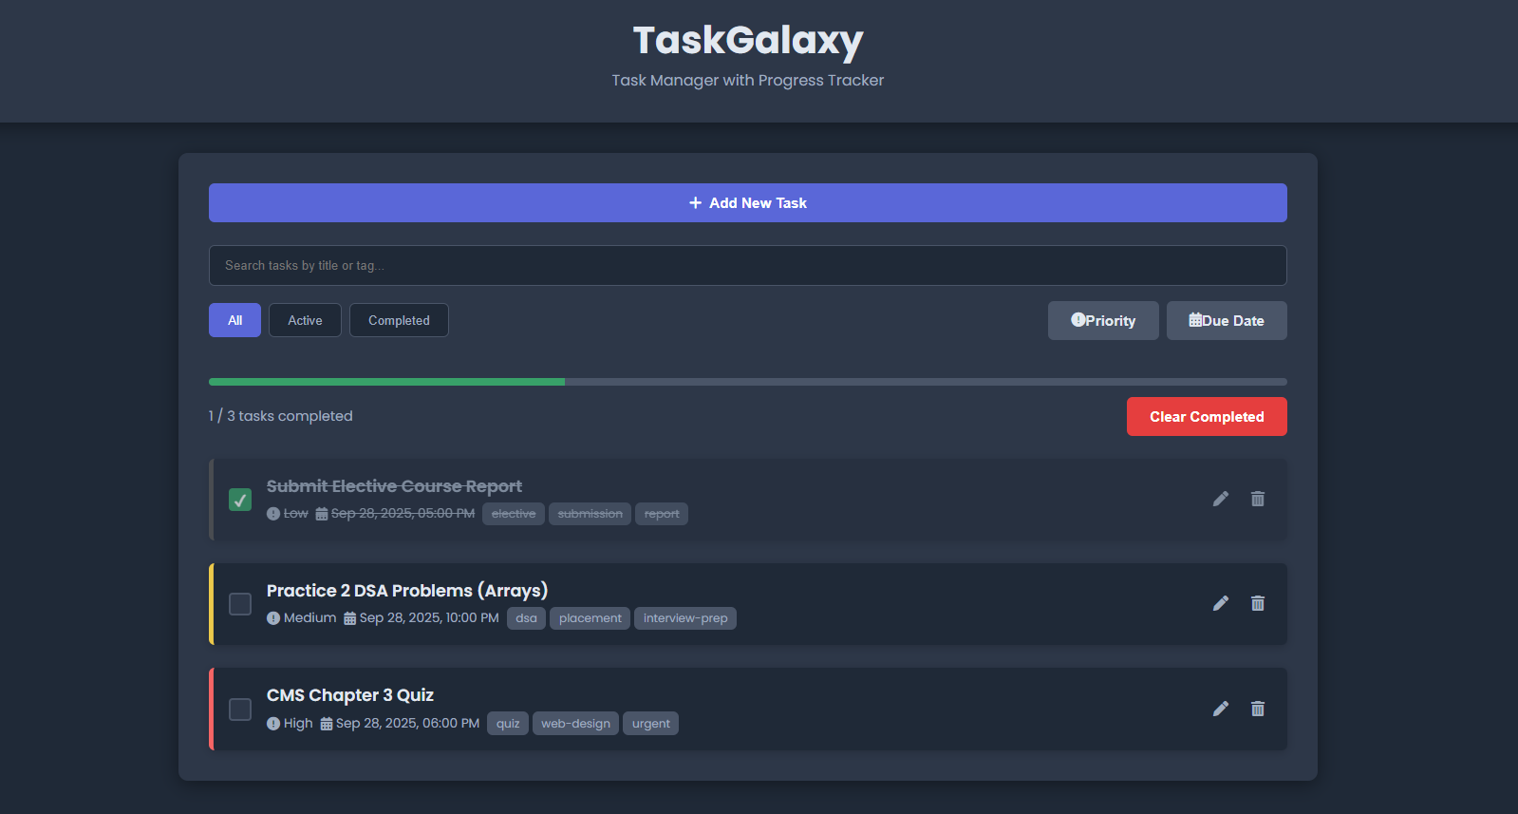
Result

Slide 8
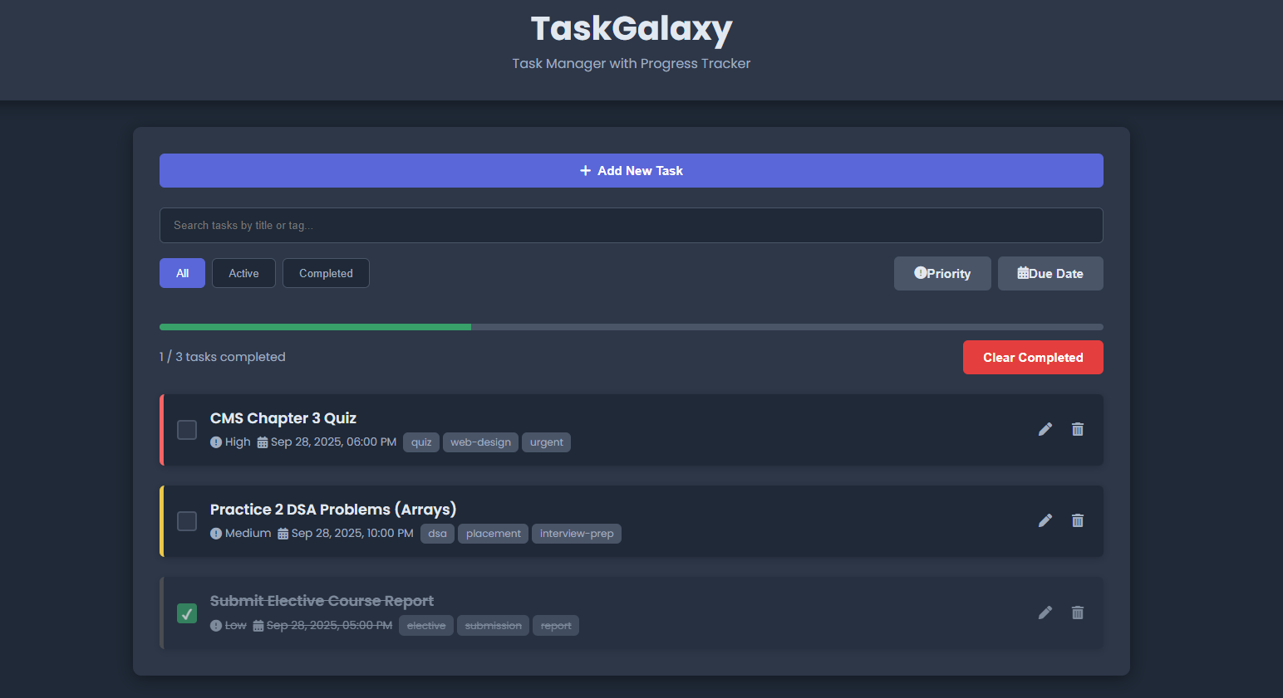
Result

Slide 9
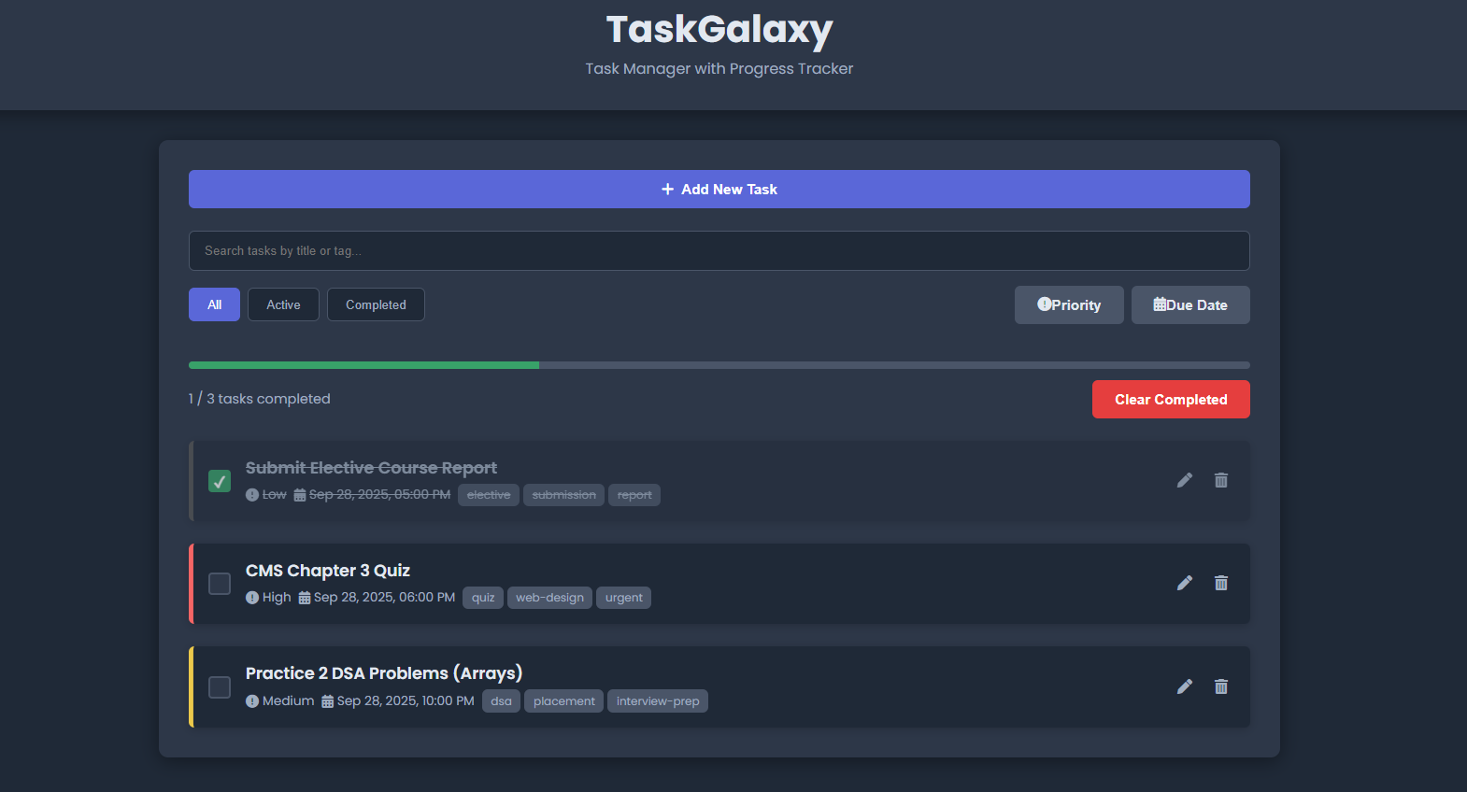
Result

Slide 10
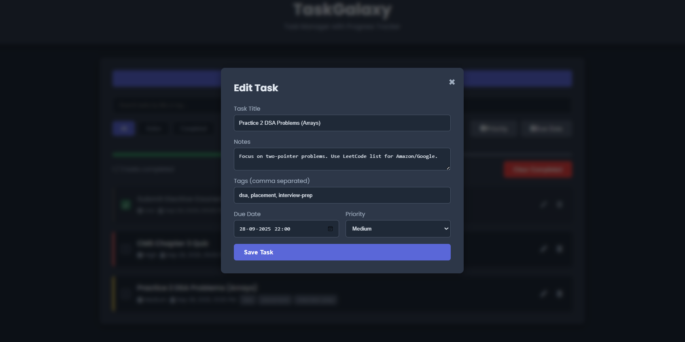
Result

Slide 11
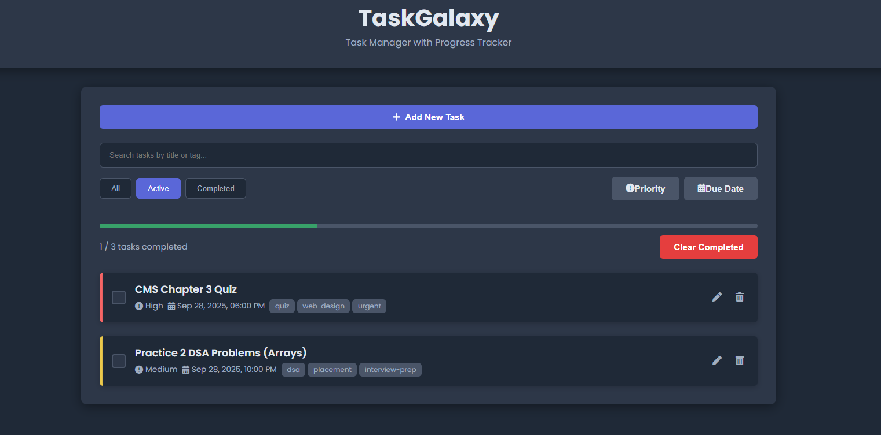
Result

Slide 12
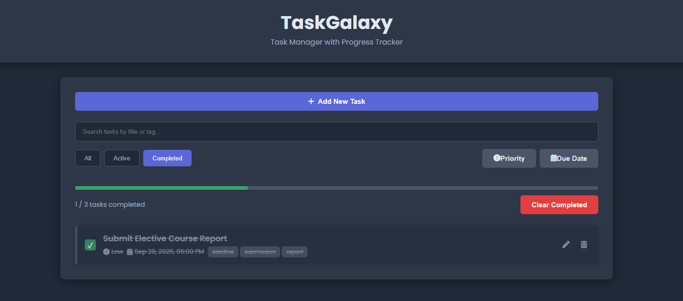
Result

Slide 13
GITHUB AND DEPLOYMNET LINK
Github Link : https://github.com/Madhurigpatil849/TaskGalaxy---Task-Manager-with-Progress-Tracker.git
Deployment Link: https://madhurigpatil849.github.io/TaskGalaxy---Task-Manager-with-Progress-Tracker/

Slide 14
Conclusion
The TaskGalaxy successfully provides a functional and interactive Task Manager with Progress Tracker.
It offers a cost-effective and standalone solution for personal productivity as it doesn't require a backend or database (uses Local Storage).
It provides an engaging and interactive user experience through real-time updates, filtering, sorting, and progress visualization.

Slide 15
Future scope(Optional)
Add backend integration (Node.js) for multi-device synchronization and order management.
Implement User Authentication to secure personal data.
Admin dashboard for comprehensive inventory/task updates (if scaled to a business context).
AI-based product/task recommendations.

Slide 16
References
Core Documentation (MDN Web Docs): Used for fundamental standards in HTML, CSS, JavaScript, and the Web Storage API (Local Storage) implementation.
Project Template: NanthiniMoha/TNSDC-FWD-DIGITAL_PORTFOLIO (Cited for the required structure and outline of the report/presentation).
Design & Framework Influence: Get started with Bootstrap v5.3 (Referenced for modern, responsive frontend design concepts).
Completion Animation: canvas-confetti [JavaScript Library] (Used to create the visual feedback at 100% task completion).
Task Management Concepts: Task Management System (TMS): Key Components and Principles (Academic reference for core features like prioritization and tracking).

Slide 17
THANK YOU

